Slide 1
Vive la Vélorution!
www.velorution.ch

Slide 2
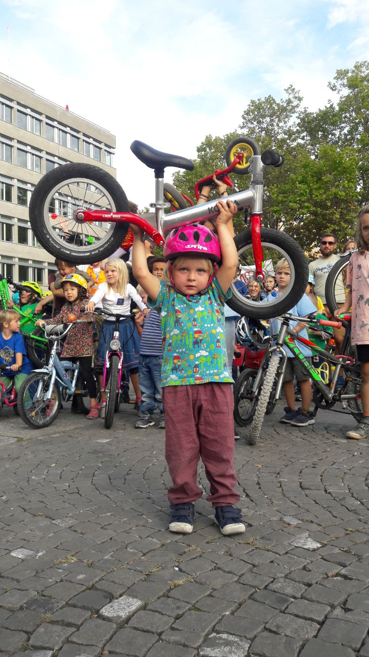

Slide 6
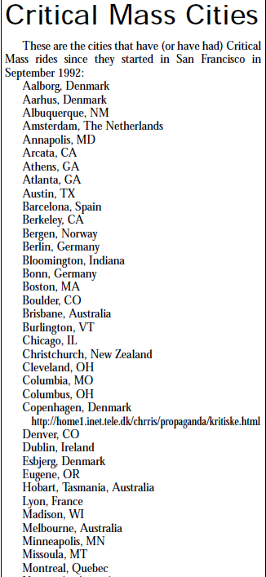
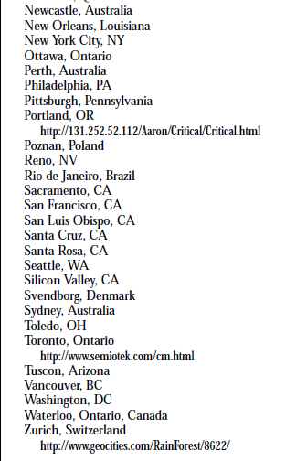

Slide 7
What is Critical Mass?
https://www.youtube.com/watch?v=IAi1MUe3pi0&t=

